Slide 1

Distribution Intelligence
Technical Process Overview
Every data pack you subscribe to, every public source, and your own commercial data, unified into one buying-unit view your sales teams and AI tools can act on.
Ingestion
→
Normalize
→
Synthesize
→
Attribute
→
Deliver
Technology overview · July 2026

Slide 2
THE PIPELINE
Seven stages, one durable asset
OVERVIEW
Intelligence Layer
Every pack, every public source, one unified buying-unit view exposed through a semantic layer and a governed MCP server.
STAGE 1
Ingestion
Client packs and public data land in your isolated tenant, native grain, native cadence, native schema preserved bit for bit.
STAGE 2
Normalization
One vocabulary across every pack. Every row resolved to a unified firm, office, team, and advisor hierarchy.
STAGE 3
Synthesize
Best Piece logic. Overlapping and complementary packs become one authoritative row per advisor per period, with lineage preserved.
STAGE 4
Attribution & Crosswalks
Office and team totals allocated down to individual advisors. Every pack's categories mapped to one taxonomy.
STAGE 5
Delivery
Dashboards, Ask Field, MCP, and data share. The same intelligence, the same vocabulary, on every surface.
STAGE 6
Foundation Compounds
Level 2 and Level 3 extend the same unified data set, semantic layer, and MCP server. Nothing gets rebuilt.
STAGE 7
Architecture & Security
Database-per-tenant isolation, defense in depth, and audit logging on every access path, including MCP.
Field · AM Distribution Intelligence
2

Slide 3
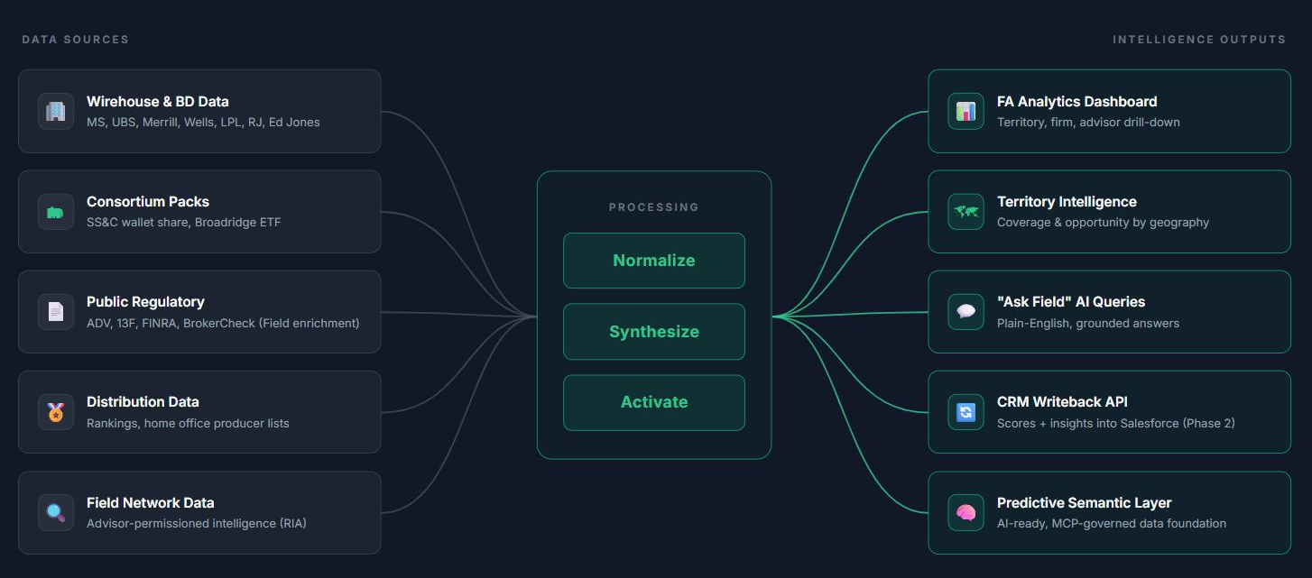
OVERVIEW
The Intelligence Layer
Field consolidates every distribution data pack an asset manager subscribes to, plus public regulatory data (ADV, 13F, FINRA, BrokerCheck), plus the manager's own commercial data into one unified, buying-unit view. Any AI tool, dashboard, or downstream system queries the same intelligence with the same vocabulary.
Field · AM Distribution Intelligence
3

Slide 4
OVERVIEW
You've already made the investment
12 to 18 mo
TIME ELIMINATED
of internal domain-expert work typically required to make distribution data AI-ready.
~90 days
KICKOFF TO LIVE
from NDA to a live platform running on your actual data packs and coverage model.
Every pack
EVERY GRAIN, ONE SCHEMA
FA, team, office, firm. Mapped to your coverage model with lineage preserved end to end.
The typical asset manager subscribes to 6+ data packs at a cost of $1M+ annually. That is before internal engineers, analysts, and infrastructure. Industry data reveals a hard truth: 80% of that spend cannot be acted on by the sales teams it was purchased for. It sits in spreadsheets and siloed systems.
The small proportional incremental spend to unify, synthesize, and activate that investment is not optional. It is the difference between your sales teams having intelligence at their fingertips and your competitors having it. As AI puts distribution intelligence at every salesperson's fingertips across the industry, the firms that built the foundation will lead. The firms that did not will play catch-up on someone else's timeline.
Field · AM Distribution Intelligence
4

Slide 5
STAGE 1
Ingestion → Normalize → Synthesize → Attribute → Deliver
Ingestion
Data flows in from two source categories: client-purchased data packs the manager already subscribes to, and public regulatory enrichment data Field sources and maintains at no incremental cost. Both land in the client's isolated Snowflake tenant at native grain, on native cadence, with native schema preserved bit for bit.
DELIVERY MECHANISMS · HOW PACKS ARRIVE
Snowflake data share (default)
Zero-copy secure share from the pack provider into the client's Field tenant. No file movement, no format conversion.
SFTP / signed upload
Per-tenant AWS S3 landing zone for any pack where Snowflake share is not offered. Files auto-route to Snowflake staging tables.
Other automation paths
S3 cross-account, SharePoint, Box, SFTP push. Same downstream pipeline, one-time setup per pack, zero ongoing client burden.
WHAT FLOWS IN
Client-purchased packs
Wirehouse and BD direct packs (MS, UBS, LPL), consortium packs (SS&C, Broadridge ETF). Field activates what you already own.
Public regulatory enrichment
ADV, 13F, FINRA BrokerCheck, rankings, rosters. Sourced and maintained by Field at no incremental cost.
Client-provided enrichment, optional
Territory mapping, FA/Team mapping, FA/Office mapping. Home office producer lists. CRM activity (Phase 2), improves FA-level attribution in Stage 4.
VALIDATION ON ARRIVAL
✓
Schema check
Column count, names, and types compared to the last known-good version. Missing or renamed columns flagged.
✓
Freshness check
Delivery period vs expected cadence. Late arrival alerts. Duplicate delivery deduped.
✓
Volume check
Row count vs historical band. Sudden drop or surge flagged for review.
VERSION DRIFT IS FIELD'S PROBLEM When a provider adds a column or restructures a category, Field absorbs it. Client engineering does not redeploy pipelines.
Field · AM Distribution Intelligence
5

Slide 6
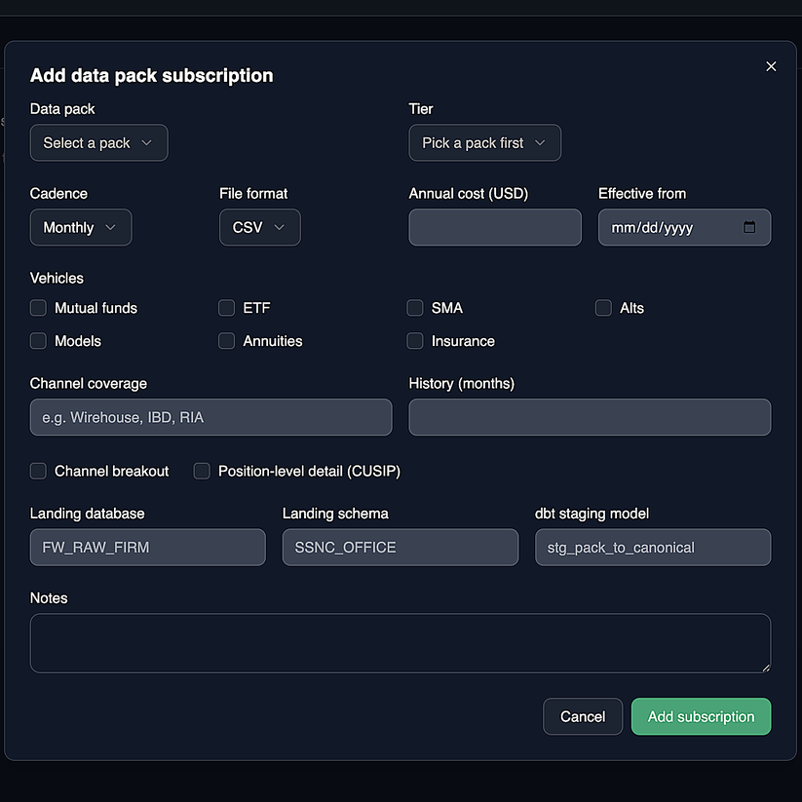
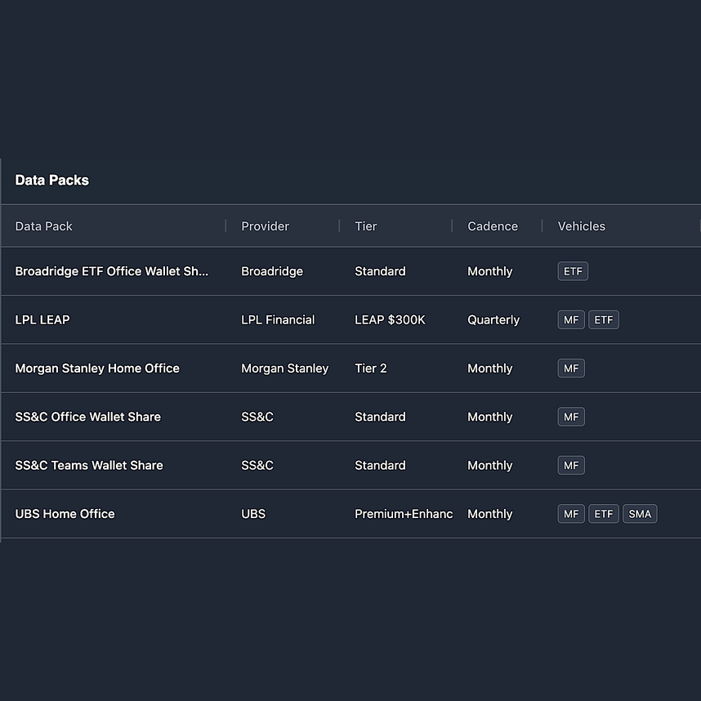
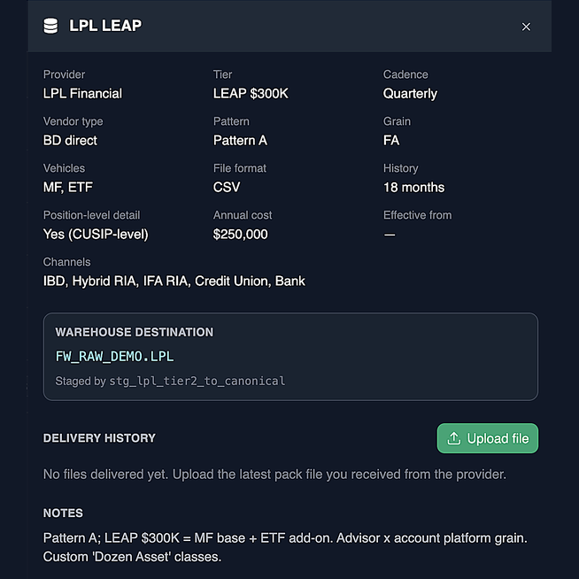
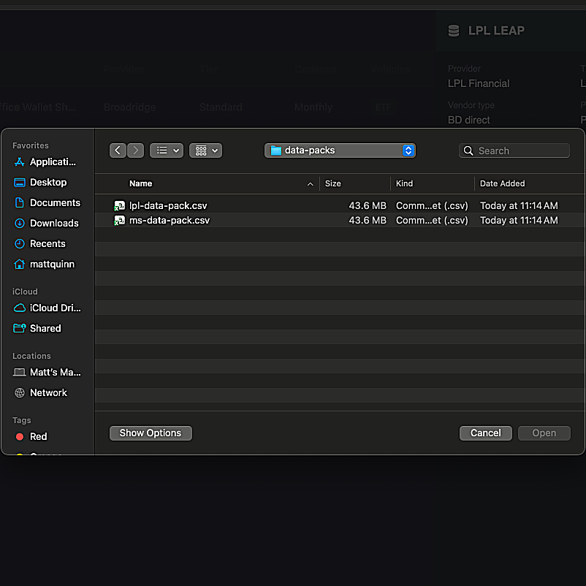
STAGE 1
Ingestion → Normalize → Synthesize → Attribute → Deliver
Data pack onboarding
Field's admin console lets our team onboard a new data pack for a client tenant in minutes, and gives the client's asset-manager users a self-serve view of their subscribed packs, delivery status, and a file-upload path for any pack not delivered via Snowflake share.
01 · Add a subscription pack
Field admin onboards a new pack: cadence, delivery mechanism, vehicle scope, pack tier.
02 · View subscribed packs
Active subscriptions at a glance: cadence, next delivery, mechanism, status.
03 · Pack details
Field-level schema, delivery history, validation status, and recent runs per pack.
04 · Upload a file
Drop a file into the tenant landing zone. Validated on arrival, routed to staging.
Field · AM Distribution Intelligence
6

Slide 7
STAGE 2
Ingestion → Normalize → Synthesize → Attribute → Deliver
Normalization
Each pack's staging layer translates raw source columns to unified Field vocabulary. Column renames, type coercion, unpivots where needed, and pack lineage tagged on every row. No cross-pack logic yet, that happens in Stage 3.
WHERE WE'RE GOING: THE FIELD GOLDEN SOURCE OF RECORD
Subset of fields shown. One row per (Month × Firm × Office × Team × FA × Vehicle × Asset Class × Platform), with lineage preserved.
MONTH | FIRM | OFFICE | TEAM/FA | CRD | VEHICLE | CATEGORY | PLATFORM | SALES OPP | AUM OPP | AM SALES | AM AUM | MKT SHARE | PERF ADV | FEE ADV
2026-03 | LPL | 4471 | Smith Grp | 6447655 | MF | US LC Blend | Advisory | $18.4M | $210M | $1.2M | $48M | 22.8% | +140bps | -12bps
2026-03 | MS | Bost-1 | Rivera Grp | 5511239 | MF | US LC Blend | Advisory | $14.8M | $188M | $0.7M | $41M | 21.8% | +120bps | -10bps
2026-03 | Ameriprise | Bost-3 | Chen Grp | 4488192 | MF | Foreign Lg Gr | Advisory | $22.1M | $342M | $0.9M | $76M | 22.2% | +95bps | -6bps
What normalization guarantees
Every normalized row carries source_pack, source_row_id, delivery_period, pack_tier, normalized_at. When a wholesaler asks “where did this number come from,” Field points back to the exact source cell in the pack file.
Field · AM Distribution Intelligence
7

Slide 8
STAGE 2
Ingestion → Normalize → Synthesize → Attribute → Deliver
One language across packs
Different packs use different column names for the same concept, sometimes with different vehicle scope. Field standardizes everything to total_aum with a vehicle tag on every row.
MS
hswh_current_assets = $175M
→
FIELD ROW
total_aum = $175M · vehicle = 'MF'
LPL
total_assets = $175M
→
FIELD ROW
total_aum = $175M · vehicle = 'MF'
SS&C Office (MF only)
total_aum_opportunity = $890M
→
FIELD ROW
total_aum = $890M · vehicle = 'MF'
Broadridge ETF
total_etf_assets = $180M
→
FIELD ROW
total_aum = $180M · vehicle = 'ETF'
Downstream benefit: any query, any dashboard, any AI tool can ask for “advisor AUM” and get the same field regardless of which pack originated the row. Vehicle scope lives in the data model as a dimension, not encoded in column names.
Field · AM Distribution Intelligence
8

Slide 9
STAGE 2
Ingestion → Normalize → Synthesize → Attribute → Deliver
Entity resolution
Every row's identifiers are resolved to Field's unified hierarchy. FA CRD (via FINRA) as the advisor primary key. Firm CRD, IARD, or FDIC as the firm identity. Office ID preserved at pack-native grain until FA attribution in Stage 4.
FIRM IDENTITY: 3-TIER HIERARCHY
Tier 1 · Pack-native
source_firm_id
SS&C's proprietary 21-char Universal Dealer code, Broadridge's SalesVision internal ID.
Tier 2 · Client-internal
extl_client_firm_id
Your CRM's own firm code. Most clients already maintain a firm-level dealer code or CRD mapping here.
Tier 3 · Industry-standard
firm_crd (BD) · firm_iard (RIA) · firm_fdic_id (Bank)
Tier 2 resolves cleanly to Tier 3 via the ADV / FINRA join. Where a client has no mapping, Field runs a matching algorithm against the FINRA broker registry to establish the Tier 3 link.
Advisor identity: FA CRD via FINRA BrokerCheck is the advisor primary key on every row, across every pack.
Field · AM Distribution Intelligence
9

Slide 10
STAGE 3
Ingestion → Normalize → Synthesize → Attribute → Deliver
Synthesize: Best Piece Logic
Best Piece is the governed logic that turns overlapping, complementary packs into one authoritative row. When multiple packs cover the same advisor, or fill different vehicle slots, this hierarchy decides which value flows through. Higher tiers win.
TIER 1 · FA-NATIVE, DIRECT FROM FIRM
MS · LPL · UBS
Sourced directly from the BD/IBD firm, native FA grain
Tier 1 rationale
BD-direct data sourced straight from the firm. Native FA grain, monthly (or quarterly for LPL) cadence, category detail where available. Highest fidelity. Best Piece defaults to Tier 1 wherever it covers the advisor.
TIER 2 · CONSORTIUM FA / TEAM GRAIN
SS&C Advisor · SS&C Teams
Consortium-sourced, not direct from firm
Tier 2 rationale
Consortium-based aggregators. FA or team grain, but not sourced directly from the firm. Higher quality than office-grain aggregators but subject to consortium coverage gaps. Used when Tier 1 does not cover the advisor.
TIER 3 · OFFICE GRAIN (ATTRIBUTION REQUIRED)
SS&C Office · Broadridge ETF
Coarser grain, allocated down to FA in Stage 4
Tier 3 rationale
Office-grain aggregators. FA Attribution (Stage 4) allocates office totals down to individual advisors using ML-profiled signals. Used for vehicles or scopes Tiers 1 and 2 do not cover.
Field · AM Distribution Intelligence
10

Slide 11
STAGE 3
Ingestion → Normalize → Synthesize → Attribute → Deliver
Best Piece in Practice
The hierarchy on the previous page determines how this plays out for a single advisor. Field synthesizes the packs that cover him into one authoritative row per advisor per period, with lineage back to every source preserved.
EXAMPLE
Advisor John Smith at LPL
FA_CRD 6447655, at LPL. Best Piece associates each vehicle's data, MF from LPL, ETF from Broadridge, competitive advantage from SS&C, to John's one record, keeping every piece without double-counting. The client subscribes to LPL's MF base pack, not the ETF add-on, and to SS&C Teams for competitive advantage.
Mutual Fund
DIRECT
ETF
ATTRIBUTED
Competitive Advantage
SYNTHESIZED
✓
LPL pack → $175M FA-native, Morningstar category detail
×
LPL ETF add-on → not subscribed by client
✓
SS&C Teams if John's team is covered → team-grain competitive advantage
×
SS&C Office → LPL firm excluded from SS&C data entirely
✓
Broadridge ETF → $180M office wallet share, attributed down to John's FA share in Stage 4
Fallback: SS&C Office office-grain competitive advantage if John's team is NOT in the Teams dataset.
Field · AM Distribution Intelligence
11

Slide 12
STAGE 3
Ingestion → Normalize → Synthesize → Attribute → Deliver
Derivation confidence flags
Every row carries a row_derivation_confidence flag describing how the value was derived. These describe method, not fidelity.
ACTUAL
SYNTHESIZED
ATTRIBUTED
Direct value emitted by a pack at the row's grain. No transformation of magnitude.
Cross-source derivation. Cadence bridging, category split, cross-pack complement (e.g., SS&C Teams competitive advantage applied to advisors whose direct pack doesn't provide it).
ML-allocated from a coarser-grain source to FA using multi-signal profiling. Every allocation carries its signal weights.
Time-derivation synthesis
Not every pack delivers on the same cadence. LPL is quarterly, MS and SS&C Office are monthly. When a query asks for March 2026 monthly data, Field synthesizes across cadences using the higher-cadence packs as proportional signals.
Example: LPL delivers Q1 2026 as one number. To render John Smith's LPL AUM monthly (Jan / Feb / Mar), Field uses the monthly trend in his office's SS&C wallet share as the proportional signal. LPL's Q1 total is split matching that curve. Row tagged Synthesized.
Cross-source complement
Some data (e.g., competitive advantage) is not available in every pack tier. Best Piece synthesizes it from adjacent sources when the client's direct pack does not surface it.
Example: if John Smith's team is covered in SS&C Teams, competitive advantage is derived from team-grain data using his LPL category holdings as the proportion signal. If the team is not covered, SS&C Office office-grain competitive advantage is used as fallback. Row tagged Synthesized.
Field · AM Distribution Intelligence
12

Slide 13
STAGE 4
Ingestion → Normalize → Synthesize → Attribute → Deliver
Attribution & Crosswalks
Two categories of work happen here. FA Attribution allocates office and team-grain data down to individual advisors, and infers advisor-level values for firms where no data pack exists at all. Crosswalks reconcile disparate categorization schemes (Morningstar granular vs LPL broad asset class, pack-native platform labels vs Field's 3-value platform taxonomy).
FA Attribution Engine
Attribution serves two use cases: allocating consortium office totals down to FA, and inferring FA-level data where no data pack covers the firm at all (RIA channel firms, IBD firms outside the subscribed set). Both use the same multi-signal ML profiling model.
SIGNAL SOURCES FEEDING THE ML PROFILE
Public regulatory. Form ADV firm AUM, FINRA registration age, license history.
Public rankings. Barron's Top 100, Forbes/Shook, FT Top Advisors.
Home office partner lists. Ameriprise Top Producers, Raymond James Presidents Club, MS Portfolio Managers Club. Firm-published high-producer signals.
Scraped rosters and focus areas. Retirement, alts, ESG specialization pulled from firm websites.
BD-direct AUM shares. For consortium attribution: known AUM in adjacent offices from Tier 1 packs.
Field · AM Distribution Intelligence
13

Slide 14
STAGE 4
Ingestion → Normalize → Synthesize → Attribute → Deliver
Multi-signal ML profiling
Every attributed value is built from weighted public and client signals, and every allocation preserves its weight vector so any number can be traced back to why an advisor received it.
SIGNAL WEIGHTS IN THE ML PROFILE (ILLUSTRATIVE)
AMERIPRISE OFFICE ALLOCATION
Office totals allocated across individual FAs using the weighted signal profile.
Tenure (FINRA)
.28
Chen · $210M
Barron's ranking
.24
Home office list
.19
Park · $175M
Office
$625M
Prior BD AUM
.14
Reid · $135M
Designations
.10
Focus areas
.05
others · $105M
Field · AM Distribution Intelligence

Slide 15
STAGE 4
Ingestion → Normalize → Synthesize → Attribute → Deliver
Ameriprise: no direct pack subscribed
The client does not subscribe to an Ameriprise-direct pack, so Field builds the Ameriprise view from consortium and public sources. The goal is not to replicate a real Ameriprise pack, but to organize what IS available into the same grain as directly covered firms so wholesalers can navigate their whole territory in one place.
1
Primary AUM source: SS&C Office and Teams. for mutual funds (both cover Ameriprise offices at office and team grain). Broadridge for ETF at office grain.
2
Push down to individual advisors. the ML Attribution Engine allocates office and team totals across the individual FAs at each Ameriprise office using multi-signal profiling.
3
Highest-value signals. home office producer lists (Ameriprise Top Producers, if the client shares them), web-scraped rosters, FINRA BrokerCheck (tenure, prior BD employment, licenses), and public rankings (Barron's, Forbes/Shook).
Confidence flag varies by signal quality. a small branch with 12 advisors, a Top Producer list, and strong web-scraped signals produces higher-confidence FA-level attributions than a large office with sparse signals. Every row carries row_derivation_confidence reflecting signal quality at that office.
4
Result. FA-grain estimates for every Ameriprise advisor, tagged Attributed, with the weight vector preserved so a wholesaler questioning any number can query why an advisor received the allocation they did. Not a substitute for a true Ameriprise data pack, but the best-organized view we can produce from the intelligence available.
→
Field · AM Distribution Intelligence
15

Slide 16
STAGE 4
Ingestion → Normalize → Synthesize → Attribute → Deliver
Crosswalks: one taxonomy for every pack
Asset Class Crosswalk. MS, UBS, and SS&C deliver at Morningstar granular category (~130 categories). LPL delivers at 8 broad asset class buckets. Field crosswalks all to a common Morningstar granular taxonomy.
MS / UBS / SS&C
Morningstar granular (~130 categories). Passed through unchanged.
LPL
Broad Asset Class (8 buckets). Inferred down to Morningstar granular categories using synthesis, with SS&C Office and Broadridge Morningstar-level office detail as the proportional signals.
Field taxonomy
Every row lands at Morningstar granular category. Broad-AC packs upshifted via synthesis using adjacent granular-category signals. Queries roll up or drill down transparently.
Platform Type Crosswalk. Every pack uses its own platform labels. Field crosswalks to a 3-value taxonomy aligned with how distribution teams think about advisor discretion.
Brokerage
Client owns the buy/sell decision. Advisor has influence.
FA Discretion Advisory
Advisory or wrap. FA has portfolio discretion.
Firm Discretion Advisory
Advisory. Firm or home office has model discretion.
Field · AM Distribution Intelligence
16

Slide 17
STAGE 5
Ingestion → Normalize → Synthesize → Attribute → Deliver
Delivery
The unified data set is exposed through multiple governed surfaces at once. The same intelligence powers an AI agent, a dashboard, a data share, or a CRM writeback API. Because grain and vocabulary are unified across every pack, the surface is a semantic-layer question, not a data-engineering question.
Semantic Layer
Documented field catalog with every element defined per pack, standardized into the unified schema. Native Snowflake Semantic View + YAML source of truth.
MCP Server
Snowflake Managed MCP Server with SQL and NL query tools. Per-tenant scoped credentials, audit-logged. Plug into Salesforce, Cursor, Claude Desktop, custom AI agents.
Ask Field
Plain-English query interface powered by MCP + semantic layer. Suggested prompts, drill-through to FA detail, exportable results.
FA Analytics Dashboard
Interactive management + wholesaler dashboards. Territory heat maps, tree charts, competitive advantage indicators.
Snowflake Data Share (Return)
Unified mart returned to your Snowflake environment. Zero-copy, live. Powers your existing BI, ML, or downstream systems.
CRM Writeback API (Phase 2)
Opportunity scores and buying-unit insights written into Salesforce via API. Wholesalers see intelligence inside their existing workflow.
Field · AM Distribution Intelligence
17

Slide 18
STAGE 5
Ingestion → Normalize → Synthesize → Attribute → Deliver
Unified golden source of record data feed
The primary deliverable alongside the dashboards. Every surface, every AI tool, every downstream system queries the same unified mart at the same grain. Delivered via Snowflake data share, MCP, or CRM writeback. Subset of fields shown, the full mart carries more dimensions and metrics.
FIELD UNIFIED MART · DELIVERED TO YOUR SNOWFLAKE / BI / AI STACK
One row per (Month × Firm × Office × Team × FA × Vehicle × Asset Class × Platform). Lineage preserved to source packs, transformation methods, and derivation confidence.
MONTH | FIRM | OFFICE | TEAM/FA | CRD | VEHICLE | CATEGORY | PLATFORM | SALES OPP | AUM OPP | AM SALES | AM AUM | MKT SHARE | PERF ADV | FEE ADV
2026-03 | LPL | 4471 | Smith Grp | 6447655 | MF | US LC Blend | Advisory | $18.4M | $210M | $1.2M | $48M | 22.8% | +140bps | -12bps
2026-03 | LPL | 4471 | Smith Grp | 6447655 | ETF | US LC Blend | Brokerage | $4.2M | $52M | $0 | $18M | 34.6% | +220bps | -8bps
2026-03 | LPL | 4471 | Smith Grp | 6447655 | SMA | Int Core Bond | Firm Disc | $1.1M | $27M | $0.3M | $8M | 29.6% | +80bps | flat
2026-03 | Ameriprise | Bost-3 | Chen Grp | 4488192 | MF | Foreign Lg Gr | Advisory | $22.1M | $342M | $0.9M | $76M | 22.2% | +95bps | -6bps
2026-03 | MS | Bost-1 | Rivera Grp | 5511239 | MF | US LC Blend | Advisory | $14.8M | $188M | $0.7M | $41M | 21.8% | +120bps | -10bps
Same data, many views: the channel, product, firm, and territory surfaces on the next page all query this one mart.

Slide 19
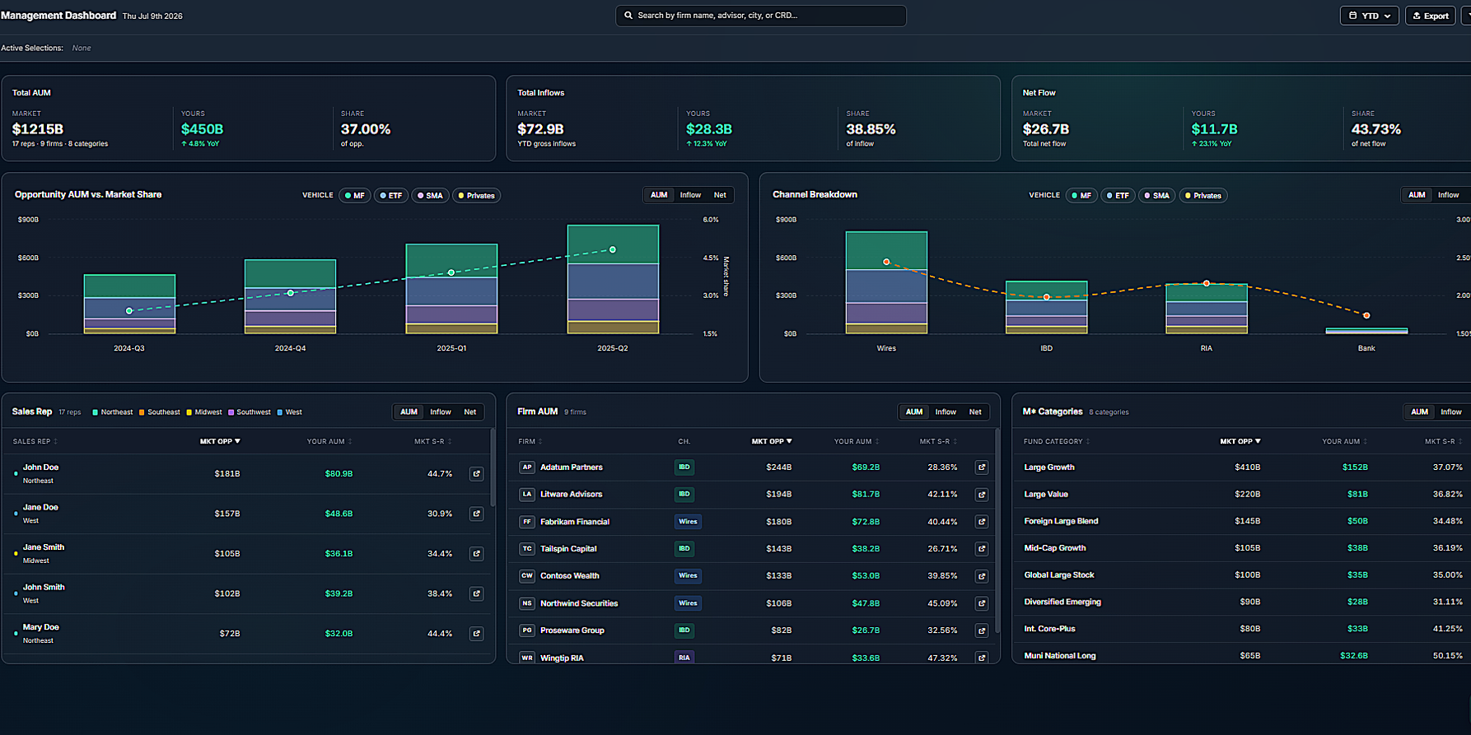
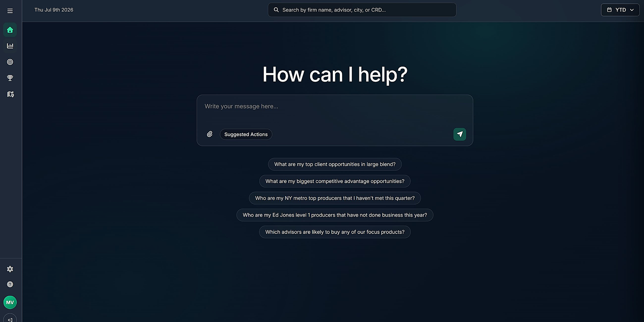
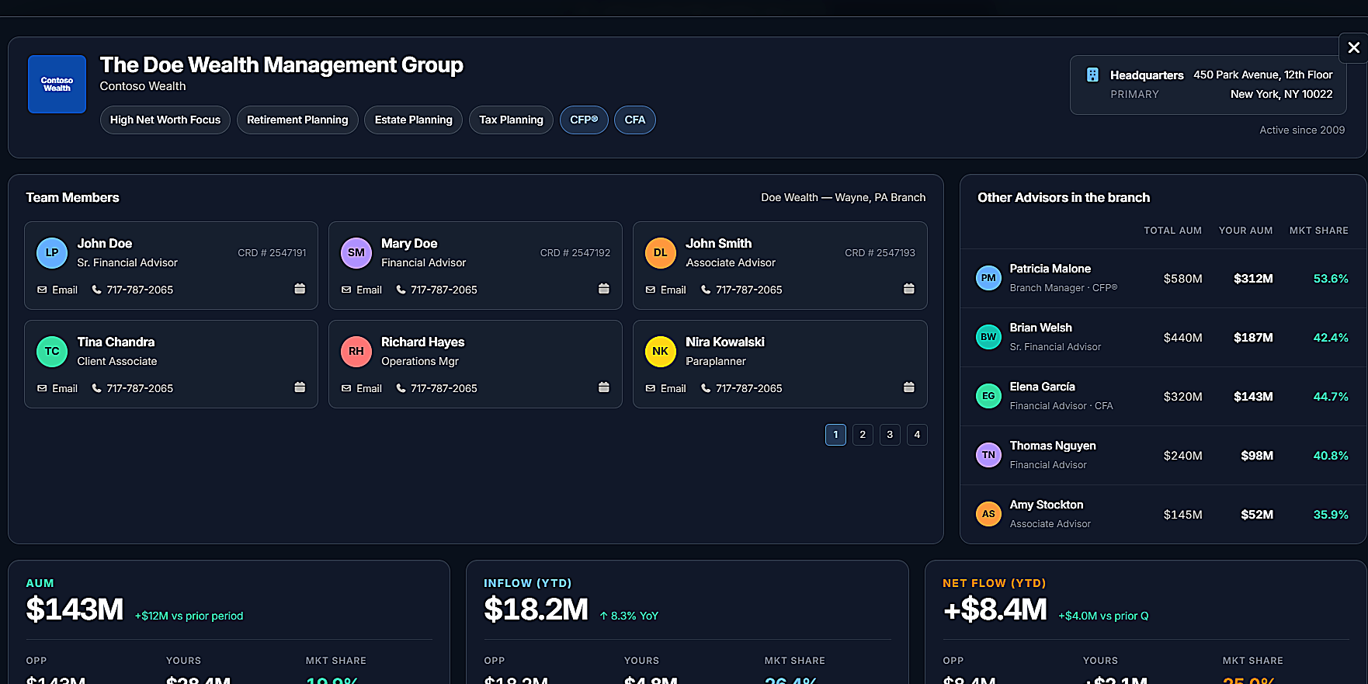
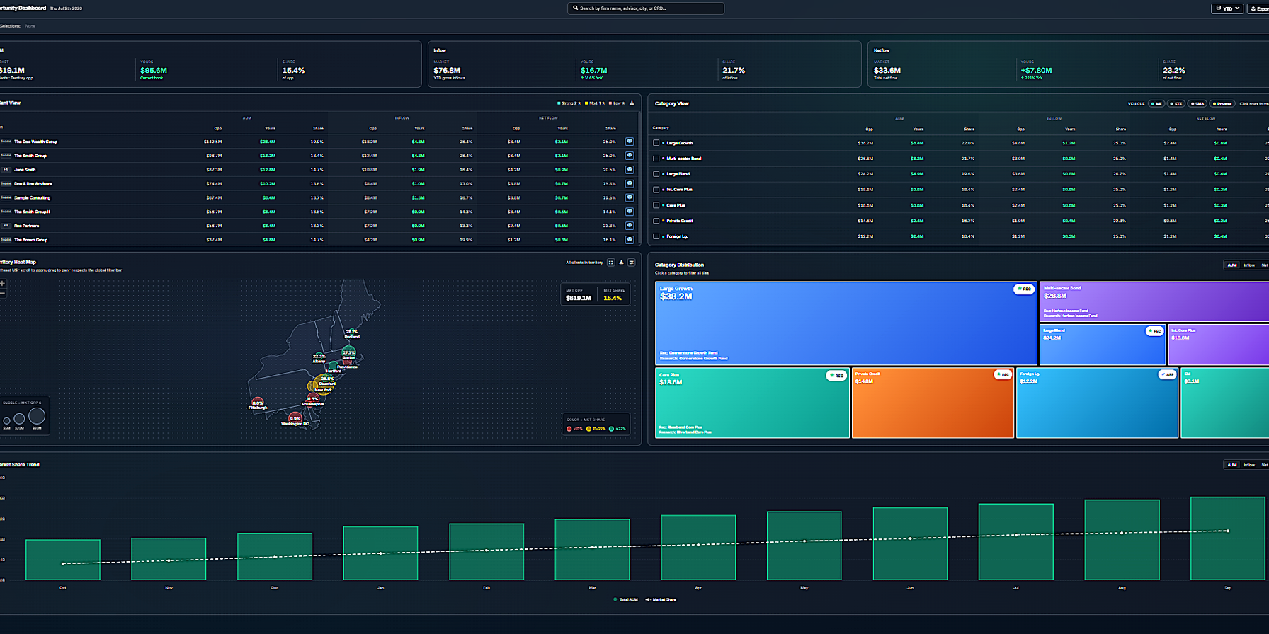
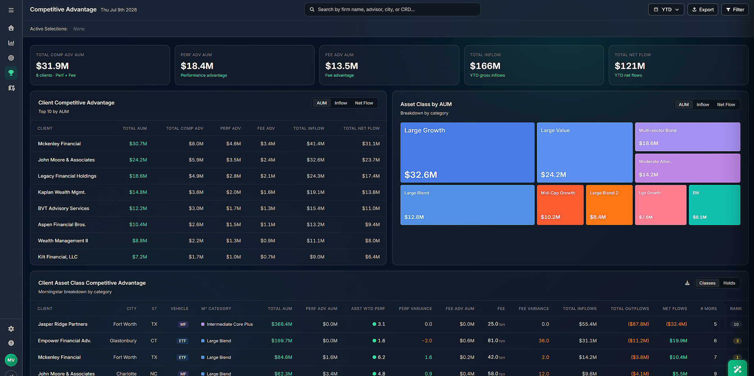
STAGE 5
Ingestion → Normalize → Synthesize → Attribute → Deliver
Interactive product surfaces
Three primary user surfaces ship on go-live: Ask Field, the management view, and the wholesaler opportunity view. Channel, product, firm, and territory views all run on the same unified mart.
Management view. Territory AUM, inflows, and net flow, opportunity vs share trend, rep leaderboard.
Ask Field. Plain-English questions over every pack, grounded answers, drill-through to client detail.
Client detail. Team and branch view: AUM and flow tiles, vehicle, platform, and category allocation.
Wholesaler opportunity dashboard. FA-level unified data. Territory heat map and category treemap.
Competitive advantage. Where you win on performance or fees versus what the advisor holds today.
Field · AM Distribution Intelligence
19

Slide 20
STAGE 6
The Foundation Compounds
Additional levels extend the same unified data set, semantic layer, and MCP server. Nothing gets rebuilt.
LEVEL 2
LEVEL 3
Advisor and Team Intelligence
Predictive Intelligence
Commercial data blended. Your sales, AUM, and CRM activity joined with the market view for timely sales attribution.
Deeper segmentation. Multi-attribute scoring designed with your analytics group, beyond a simple top-decile cut.
Closed loop tracking. Distribution effectiveness measured from opportunity identified to action executed.
Predictive models. Propensity, market basket, and regression models tuned by Field data science.
CRM writeback. Scores and insights delivered into existing workflows via API. No new UI required.
Prescriptive targeting. The right opportunity surfaced at the right time, for the products you care about most.
One durable asset that compounds in value as packs, commercial data, and models are added.
Field · AM Distribution Intelligence
20

Slide 21
STAGE 7
Architecture & Security
Field's infrastructure is designed for enterprise asset management from day one. Database-per-tenant isolation as the primary boundary, defense in depth across identity, encryption, and infrastructure layers, comprehensive audit logging on every access path including MCP.
SYSTEM ARCHITECTURE
INGESTION
Snowflake data share (default)
SFTP → S3 landing (fallback)
UNIFIED STORE
Snowflake · database-per-tenant
TRANSFORMATION
dbt Cloud (SQL DAG)
Python notebooks (ML, Level 3)
GitHub
SEMANTIC + AI
Snowflake Semantic View
Managed MCP Server
Frontier LLM’s for NLP
DASHBOARDS
ClickHouse
React.JS UI
RETURN TO CLIENT
Snowflake data share
MCP endpoint
CRM writeback API (Phase 2)
Field · AM Distribution Intelligence
21

Slide 22
STAGE 7
Multi-tenant isolation
Database-per-AM, enforced at the warehouse layer. Each client's data resides in its own Snowflake database, and every access path is scoped and logged.
Physical isolation
Each AM client's data resides in its own Snowflake database. No shared table with a tenant filter. Cross-tenant access is impossible by design.
Role-based access
RBAC roles scoped per tenant. Service accounts and users bound to their tenant's database only.
Dynamic data masking
Column-level PII masks applied at query time based on role.
MCP tenancy
MCP credentials are per-tenant. Every call scoped to a single tenant's database. Short-lived tokens, audit-logged.
WHY DATABASE-PER-TENANT MATTERS
Shared-schema-with-tenant-filter designs, even done well, carry nonzero risk. Field eliminates that class of risk by making cross-tenant access architecturally impossible, not just policy-blocked. Combined with per-tenant MCP credentialing and audit logging, the security posture matches what large asset managers already require for their internal Snowflake tenants.
Field · AM Distribution Intelligence
22

Slide 23
STAGE 7
Identity, access, encryption, infrastructure
IDENTITY & ACCESS
ENCRYPTION & INFRASTRUCTURE
Field UI
Amazon Cognito with TOTP MFA. Federated sign-in via Microsoft Entra and Google.
At-rest encryption
Snowflake, S3, ClickHouse. All storage encrypted at rest by default.
Snowflake · humans
SSO via client IdP. MFA enforced upstream.
Secrets management
AWS Secrets Manager. Zero credentials in source code.
Service authentication
IAM Roles for Service Accounts. No long-lived keys.
Snowflake · services
Key-pair authentication. Quarterly key rotation.
Configuration scanning
AWS config scanned daily against CIS benchmark.
MCP access
Scoped service credentials, per-AM tenancy isolation, short-lived tokens, audit-logged with actor, tool, and query.
Change management
Terraform pipeline with audit trail. No click-ops in production.
Transport
TLS 1.2+ enforced on all endpoints.
Hosting
AWS US-East-1. SOC 2 Type II environment.
Every access path, including MCP, is audit-logged with actor, tool, and query.
Field · AM Distribution Intelligence
23

